Slide 1
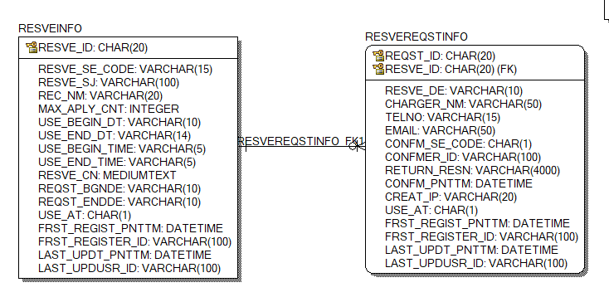
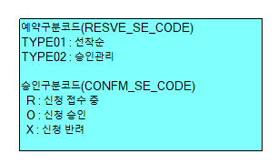
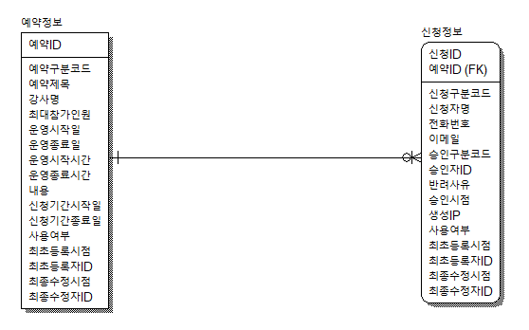

Slide 2
CREATE TABLE RESVEINFO
(
RESVE_ID CHAR(20) NOT NULL,
RESVE_SE_CODE VARCHAR(15) NULL,
RESVE_SJ VARCHAR(100) NULL,
REC_NM VARCHAR(20) NULL,
MAX_APLY_CNT INTEGER NULL,
USE_BEGIN_DT VARCHAR(10) NULL,
USE_END_DT VARCHAR(14) NULL,
USE_BEGIN_TIME VARCHAR(5) NULL,
USE_END_TIME VARCHAR(5) NULL,
RESVE_CN MEDIUMTEXT NULL,
REQST_BGNDE VARCHAR(10) NULL,
REQST_ENDDE VARCHAR(10) NULL,
USE_AT CHAR(1) NULL,
FRST_REGIST_PNTTM DATETIME NULL,
FRST_REGISTER_ID VARCHAR(100) NULL,
LAST_UPDT_PNTTM DATETIME NULL,
LAST_UPDUSR_ID VARCHAR(100) NULL
);
ALTER TABLE RESVEINFO
ADD PRIMARY KEY (RESVE_ID);

Slide 3
ALTER TABLE RESVEINFO COMMENT = '예약정보';
ALTER TABLE RESVEINFO CHANGE COLUMN RESVE_ID RESVE_ID CHAR(20) NOT NULL COMMENT '예약ID';
ALTER TABLE RESVEINFO CHANGE COLUMN RESVE_SE_CODE RESVE_SE_CODE VARCHAR(15) NULL COMMENT '예약구분코드';
ALTER TABLE RESVEINFO CHANGE COLUMN RESVE_SJ RESVE_SJ VARCHAR(100) NULL COMMENT '예약제목';
ALTER TABLE RESVEINFO CHANGE COLUMN REC_NM REC_NM VARCHAR(20) NULL COMMENT '강사명';
ALTER TABLE RESVEINFO CHANGE COLUMN MAX_APLY_CNT MAX_APLY_CNT INTEGER NULL COMMENT '최대참가인원';
ALTER TABLE RESVEINFO CHANGE COLUMN USE_BEGIN_DT USE_BEGIN_DT VARCHAR(10) NULL COMMENT '운영시작일';
ALTER TABLE RESVEINFO CHANGE COLUMN USE_END_DT USE_END_DT VARCHAR(14) NULL COMMENT '운영종료일';
ALTER TABLE RESVEINFO CHANGE COLUMN USE_BEGIN_TIME USE_BEGIN_TIME VARCHAR(5) NULL COMMENT '운영시작시간';
ALTER TABLE RESVEINFO CHANGE COLUMN USE_END_TIME USE_END_TIME VARCHAR(5) NULL COMMENT '운영종료시간';
ALTER TABLE RESVEINFO CHANGE COLUMN RESVE_CN RESVE_CN MEDIUMTEXT NULL COMMENT '내용';
ALTER TABLE RESVEINFO CHANGE COLUMN REQST_BGNDE REQST_BGNDE VARCHAR(10) NULL COMMENT '신청기간시작일';
ALTER TABLE RESVEINFO CHANGE COLUMN REQST_ENDDE REQST_ENDDE VARCHAR(10) NULL COMMENT '신청기간종료일';
ALTER TABLE RESVEINFO CHANGE COLUMN USE_AT USE_AT CHAR(1) NULL COMMENT '사용여부';
ALTER TABLE RESVEINFO CHANGE COLUMN FRST_REGIST_PNTTM FRST_REGIST_PNTTM DATETIME NULL COMMENT '최초등록시점';
ALTER TABLE RESVEINFO CHANGE COLUMN FRST_REGISTER_ID FRST_REGISTER_ID VARCHAR(100) NULL COMMENT '최초등록자ID';
ALTER TABLE RESVEINFO CHANGE COLUMN LAST_UPDT_PNTTM LAST_UPDT_PNTTM DATETIME NULL COMMENT '최종수정시점';
ALTER TABLE RESVEINFO CHANGE COLUMN LAST_UPDUSR_ID LAST_UPDUSR_ID VARCHAR(100) NULL COMMENT '최종수정자ID';

Slide 4
CREATE TABLE RESVEREQSTINFO
(
REQST_ID CHAR(20) NOT NULL,
RESVE_ID CHAR(20) NOT NULL,
RESVE_DE VARCHAR(10) NULL,
CHARGER_NM VARCHAR(50) NULL,
TELNO VARCHAR(15) NULL,
EMAIL VARCHAR(50) NULL,
CONFM_SE_CODE CHAR(1) NULL,
CONFMER_ID VARCHAR(100) NULL,
RETURN_RESN VARCHAR(4000) NULL,
CONFM_PNTTM DATETIME NULL,
CREAT_IP VARCHAR(20) NULL,
USE_AT CHAR(1) NULL,
FRST_REGIST_PNTTM DATETIME NULL,
FRST_REGISTER_ID VARCHAR(100) NULL,
LAST_UPDT_PNTTM DATETIME NULL,
LAST_UPDUSR_ID VARCHAR(100) NULL
);
ALTER TABLE RESVEREQSTINFO
ADD PRIMARY KEY (REQST_ID,RESVE_ID);
ALTER TABLE RESVEREQSTINFO
ADD FOREIGN KEY RESVEREQSTINFO_FK1 (RESVE_ID) REFERENCES RESVEINFO (RESVE_ID);

Slide 5
ALTER TABLE RESVEREQSTINFO COMMENT = '신청정보';
ALTER TABLE RESVEREQSTINFO CHANGE COLUMN REQST_ID REQST_ID CHAR(20) NOT NULL COMMENT '신청ID';
ALTER TABLE RESVEREQSTINFO CHANGE COLUMN RESVE_ID RESVE_ID CHAR(20) NOT NULL COMMENT '예약ID';
ALTER TABLE RESVEREQSTINFO CHANGE COLUMN RESVE_DE RESVE_DE VARCHAR(10) NULL COMMENT '신청구분코드';
ALTER TABLE RESVEREQSTINFO CHANGE COLUMN CHARGER_NM CHARGER_NM VARCHAR(50) NULL COMMENT '신청자명';
ALTER TABLE RESVEREQSTINFO CHANGE COLUMN TELNO TELNO VARCHAR(15) NULL COMMENT '전화번호';
ALTER TABLE RESVEREQSTINFO CHANGE COLUMN EMAIL EMAIL VARCHAR(50) NULL COMMENT '이메일';
ALTER TABLE RESVEREQSTINFO CHANGE COLUMN CONFM_SE_CODE CONFM_SE_CODE CHAR(1) NULL COMMENT '승인구분코드';
ALTER TABLE RESVEREQSTINFO CHANGE COLUMN CONFMER_ID CONFMER_ID VARCHAR(100) NULL COMMENT '승인자ID';
ALTER TABLE RESVEREQSTINFO CHANGE COLUMN RETURN_RESN RETURN_RESN VARCHAR(4000) NULL COMMENT '반려사유';
ALTER TABLE RESVEREQSTINFO CHANGE COLUMN CONFM_PNTTM CONFM_PNTTM DATETIME NULL COMMENT '승인시점';
ALTER TABLE RESVEREQSTINFO CHANGE COLUMN CREAT_IP CREAT_IP VARCHAR(20) NULL COMMENT '생성IP';
ALTER TABLE RESVEREQSTINFO CHANGE COLUMN USE_AT USE_AT CHAR(1) NULL COMMENT '사용여부';
ALTER TABLE RESVEREQSTINFO CHANGE COLUMN FRST_REGIST_PNTTM FRST_REGIST_PNTTM DATETIME NULL COMMENT '최초등록시점';
ALTER TABLE RESVEREQSTINFO CHANGE COLUMN FRST_REGISTER_ID FRST_REGISTER_ID VARCHAR(100) NULL COMMENT '최초등록자ID';
ALTER TABLE RESVEREQSTINFO CHANGE COLUMN LAST_UPDT_PNTTM LAST_UPDT_PNTTM DATETIME NULL COMMENT '최종수정시점';
ALTER TABLE RESVEREQSTINFO CHANGE COLUMN LAST_UPDUSR_ID LAST_UPDUSR_ID VARCHAR(100) NULL COMMENT '최종수정자ID';

Slide 6
<!-- RESVEINFO START-->
<bean name="egovRsvIdGnrService"
class="egovframework.rte.fdl.idgnr.impl.EgovTableIdGnrServiceImpl"
destroy-method="destroy">
<property name="dataSource" ref="egov.dataSource" />
<property name="strategy" ref="rsvStrategy" />
<property name="blockSize" value="10"/>
<property name="table" value="IDS"/>
<property name="tableName" value="RSV_ID"/>
</bean>
<bean name="rsvStrategy"
class="egovframework.rte.fdl.idgnr.impl.strategy.EgovIdGnrStrategyImpl">
<property name="prefix" value="RSV_" />
<property name="cipers" value="16" />
<property name="fillChar" value="0" />
</bean>
<!-- RESVEINFO END-->

Slide 7
<!-- RESVEREQSTINFO START-->
<bean name="egovReqIdGnrService"
class="egovframework.rte.fdl.idgnr.impl.EgovTableIdGnrServiceImpl"
destroy-method="destroy">
<property name="dataSource" ref="egov.dataSource" />
<property name="strategy" ref="reqStrategy" />
<property name="blockSize" value="10"/>
<property name="table" value="IDS"/>
<property name="tableName" value="RQT_ID"/>
</bean>
<bean name="reqStrategy"
class="egovframework.rte.fdl.idgnr.impl.strategy.EgovIdGnrStrategyImpl">
<property name="prefix" value="RQT_" />
<property name="cipers" value="16" />
<property name="fillChar" value="0" />
</bean>
<!-- RESVEREQSTINFO END-->

Slide 8
INSERT INTO ids
(TABLE_NAME, NEXT_ID)
VALUES('RSV_ID', 1);
INSERT INTO ids
(TABLE_NAME, NEXT_ID)
VALUES('RQT_ID', 1);

Slide 9
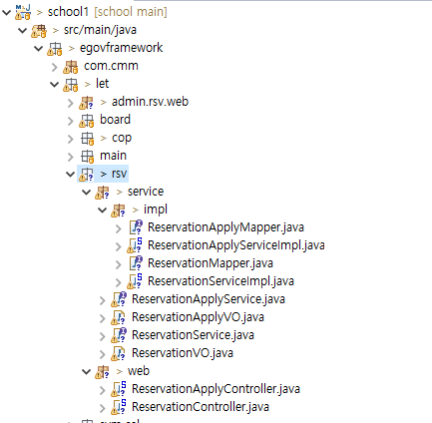
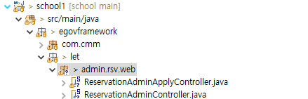
* admin 패키지 만들기
* rsv 패키지 만들기

Slide 10
* web.xml 추가
<servlet-mapping>
<servlet-name>action</servlet-name>
<url-pattern>*.json</url-pattern>
</servlet-mapping>

Slide 11

Header.jsp 관리자 부분에 예약관리 추가

Slide 12
데이터 넣어보고 선착순이랑 승인관리 잘 나오는지 확인
INSERT INTO RESVEINFO (
RESVE_ID
, RESVE_SE_CODE
, RESVE_SJ
, REC_NM
, MAX_APLY_CNT
, USE_BEGIN_DT
, USE_END_DT
, USE_BEGIN_TIME
, USE_END_TIME
, RESVE_CN
, REQST_BGNDE
, REQST_ENDDE
, USE_AT
, FRST_REGIST_PNTTM
, FRST_REGISTER_ID
, LAST_UPDT_PNTTM
, LAST_UPDUSR_ID
) VALUES (
'TEST_000000000000001'
, 'TYPE01'
, '테스트 프로그램1'
, '문성진'
, 3
, '2024-09-25'
, '2024-09-27'
, '09:00'
, '16:00'
, '내용'
, '2024-09-23'
, '2024-09-24'
, 'Y'
, NOW()
, 'admin'
, NOW()
, 'admin'
);
INSERT INTO RESVEINFO (
RESVE_ID
, RESVE_SE_CODE
, RESVE_SJ
, REC_NM
, MAX_APLY_CNT
, USE_BEGIN_DT
, USE_END_DT
, USE_BEGIN_TIME
, USE_END_TIME
, RESVE_CN
, REQST_BGNDE
, REQST_ENDDE
, USE_AT
, FRST_REGIST_PNTTM
, FRST_REGISTER_ID
, LAST_UPDT_PNTTM
, LAST_UPDUSR_ID
) VALUES (
'TEST_000000000000002'
, 'TYPE02'
, '테스트 프로그램2'
, '문성진'
, 3
, '2024-09-25'
, '2024-09-27'
, '09:00'
, '16:00'
, '내용'
, '2024-09-23'
, '2024-09-24'
, 'Y'
, NOW()
, 'admin'
, NOW()
, 'admin'
);

